Slide 1
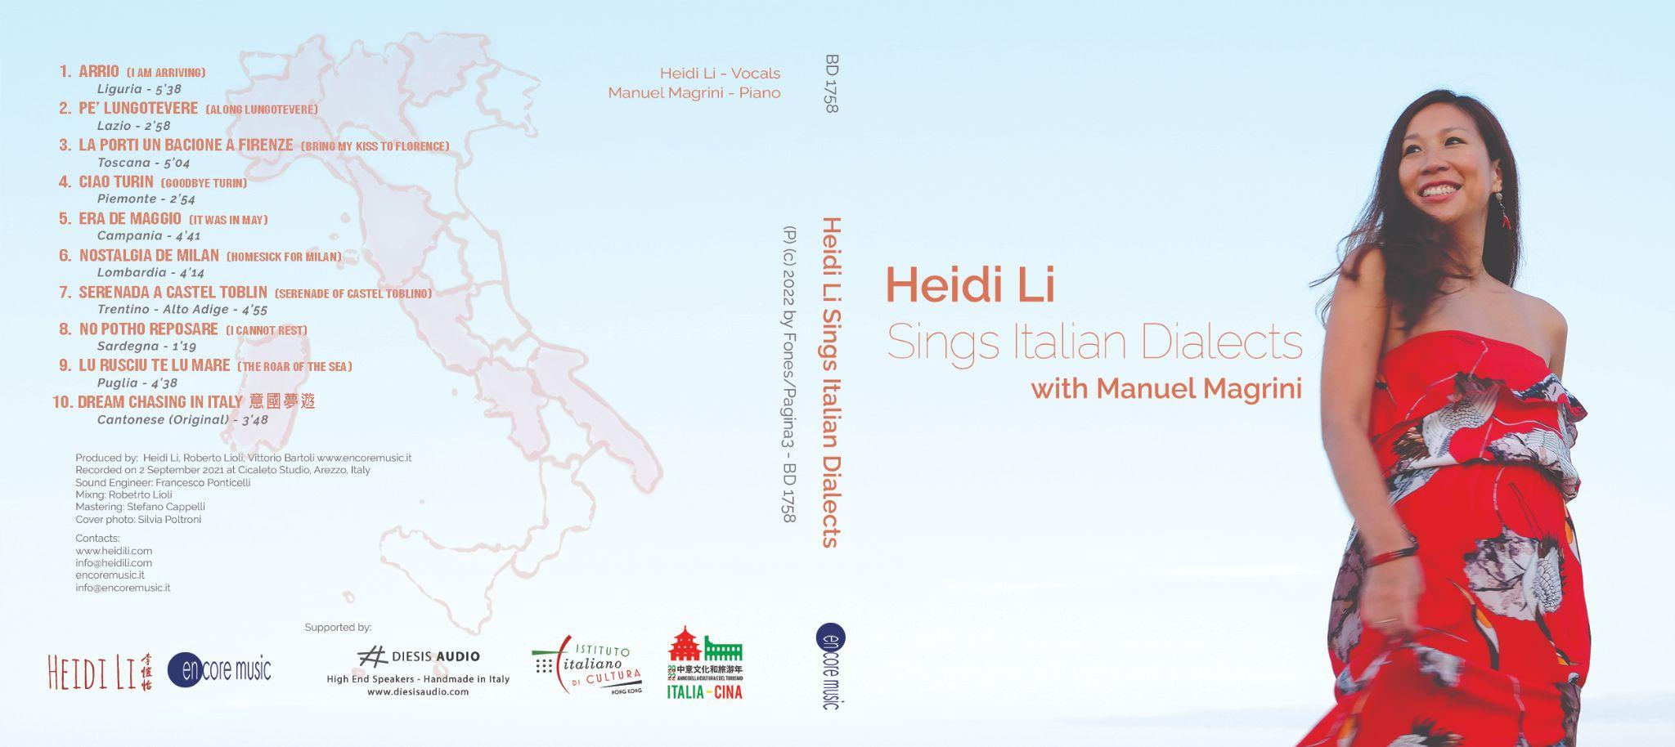

Slide 2
Heidi Li is a Hong Kong born Jazz vocalist, singing teacher and composer. She grew up with a Cantonese opera background under her parents’ influence. After having lived in Canada, the UK and France, she had been living in Italy for more than 8 years, where she completed a degree in Vocal Jazz Performance at Siena Jazz University. With her thesis titled “Xiqu meets Jazz: The possibilities of incorporating musical structures and expressions of Cantonese Opera in Jazz”, she graduated with the full marks of 110.
With her project “Heidi Sings Italian Dialects”, she was invited by the Italian Ministry of Foreign Affairs to sing at the 2016 States General of the Italian Language in the World in Florence. In 2022, with the support of the Italian Cultural Institute Hong Kong & Macau, she recorded and published a new album of the same project.
In recent years she continues to perform, produce and teach across Europe and Asia in a variety of events such as Italian National Day Concert (HK), HangZhou Jazz On the Lake Festival (CN), Salento Film Festival (IT) and Freespace Jazz Festival (HK).

Slide 3
李愷怡是香港土生土長的爵士創作歌手。自小受父母薰陶下學習粵劇粵曲，11歲時在香港無線電視的粵曲霸主挑戰賽中得到冠軍。曾留學加拿大，英國及法國。隨後定居意大利，在錫耶納爵士大學（Siena Jazz University）攻讀爵士歌唱學位，憑論文”中國戲曲和爵士的結合：廣東粵曲音樂結構和表達在爵士樂的應用”以110分滿分畢業。
2016年10月憑著《Heidi Sings Italian Dialects》計劃得到意大利外交部賞識以及邀請，在佛羅倫斯舊宮舉行的States General of the Italian Language in the World獻唱。2022年得到駐香港及澳門意大利文化處支助，以同灌錄及推出此計劃的大碟。近年繼續活躍於國內外的表演、創作和教學活動，其中包括意大利國慶日演奏會（香港）、杭州爵士文旅音樂節（杭州）、薩蘭托國際電影節（意大利）和自由爵士音樂節（香港）等等。

Slide 4
Songs
1. Arrio/ I am arriving (testo:Elio Mereu; musica:Gian Franco Reverberi)
2. Pe’ Lungotevere/ Along Lungotevere (testo: Rinaldo Frapiselli – musica: Romolo Balzani)
3. La porti un bacione a Firenze/ Bring my Kiss to Florence (Odoardo Spadaro)
4. Ciao Turin/ Goodbye Turin (testo: Lampo; musica: Carlo Prato)
5. Era de Maggio/ It was in May (Testo: Salvatore Di Giacomo; musica: Mario Costa)
6. Nostalgia de Milan / Homesick for Milan (testo: Alfredo Bracchi; musica: Giovanni D'anzi)
7. Serenada a Castel Toblin / Serenade of Castel Toblin (Luigi Pigarelli)
8. No Potho Reposare/ I cannot rest (testo: Salvatore Sini; musica: Giuseppe Rachel)
9. Lu Rusciu te lu Mare / The Roar of the Sea
10. 意國夢遊Dream Chasing In Italy (Heidi Li)
All Songs are featured in “Music Chasing in Italy” Series on the Youtube Channel of Italian Cultural Institute Hong Kong and Macau
https://www.youtube.com/playlist?list=PLcCf927m-xQE0XSwvRWu0SLliR2cF0zce
Il disco su Spotify https://open.spotify.com/album/4jGXp7vrvSWv5MiLDqDyLV?si=AkRej8YuQeezeWrUphyxjg

Slide 5

Heidi Li- Voice
Heidi Li is a Hong Kong born multicultural and multilingual Jazz vocalist, composer and teacher. Under her parents' guidance, Heidi grew up performing Yuequ (Cantonese Opera) and won a yuequ singing competition at 11 years old on a local Hong Kong TV channel.
Heidi has lived abroad in Canada, the UK and France before settling in Italy, where she developed the passion for Jazz and improvisation. She graduated from Siena Jazz University with full marks of 110, exploring the integration of Yuequ elements in Jazz composition and performance for her thesis and recital.
In 2016, Heidi released her debut EP "Third Culture Kid," featuring six original compositions in English, Italian, and Cantonese, reflecting her multicultural upbringing. Her “Heidi Sings Italian Dialects” project has earned her recognition from the Italian Ministry of Foreign Affairs, particularly with her performance at the 2016 States General of the Italian Language in the World in Florence. In 2022, with support from the Italian Cultural Institute Hong Kong & Macau, her second album was published.
In recent years, Heidi continues to perform, produce, and teach in Europe and Asia at events such as the Italian National Day celebration (HK), the HangZhou Jazz On the Lake Festival (CN), the Salento Film Festival (IT), and the Freespace Jazz Festival (HK) etc. Embracing a new challenge in 2023, Heidi stepped into the world of movie soundtracks as the composer for Nabin Subba's feature film "A Road to a Village” (World Premiered at TIFF 2023), starring celebrated Nepali actor Dayahang Rai.

Slide 6
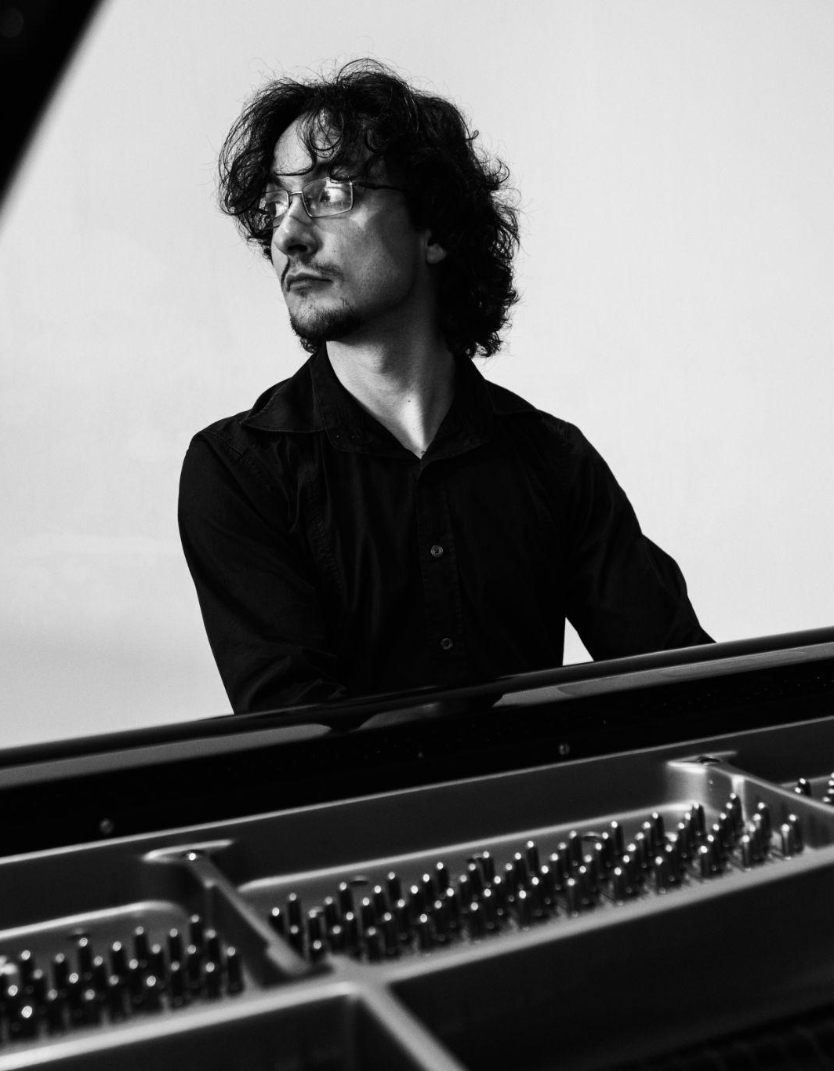
Manuel Magrini - Piano
Manuel Magrini, born in 1990, won the 2017 Lelio Luttazzi Prize at the prestigious jazz club Blue Note Milano. He developed an interest in jazz music at a young age and started learning the craft from maestro Ramberto Ciammarughi. He has collaborated with numerous groups, performing across Europe, Asia, Middle East and America.
Since 2014, he has been part of the National Orchestra of Young Jazz Talents organized by the Teatro Puccini in Florence, Siena Jazz, and Music Pool. This orchestra is comprised of the best jazz department students from all the Conservatories in Italy, with whom he has performed on significant stages like the Teatro Piccolo Strehler in Milan and the Obi Hall in Florence. In the same year, Manuel received a scholarship at the Fara Music Festival to study at the Collective School of Music in New York.
In 2016, his first solo piano CD titled "Unexpected" was released under the Encore Jazz label by Roberto Lioli. Manuel presented the album in various locations, including Domus Art Centro Cultura in Naples, the Izmir European Jazz Festival in Smyrna, Teatro la Fenice in Venice, Sala Vanni in Florence, Casa del Jazz in Rome, Folk Club in Turin, and Piazza Sheraton in Milan.

Slide 7
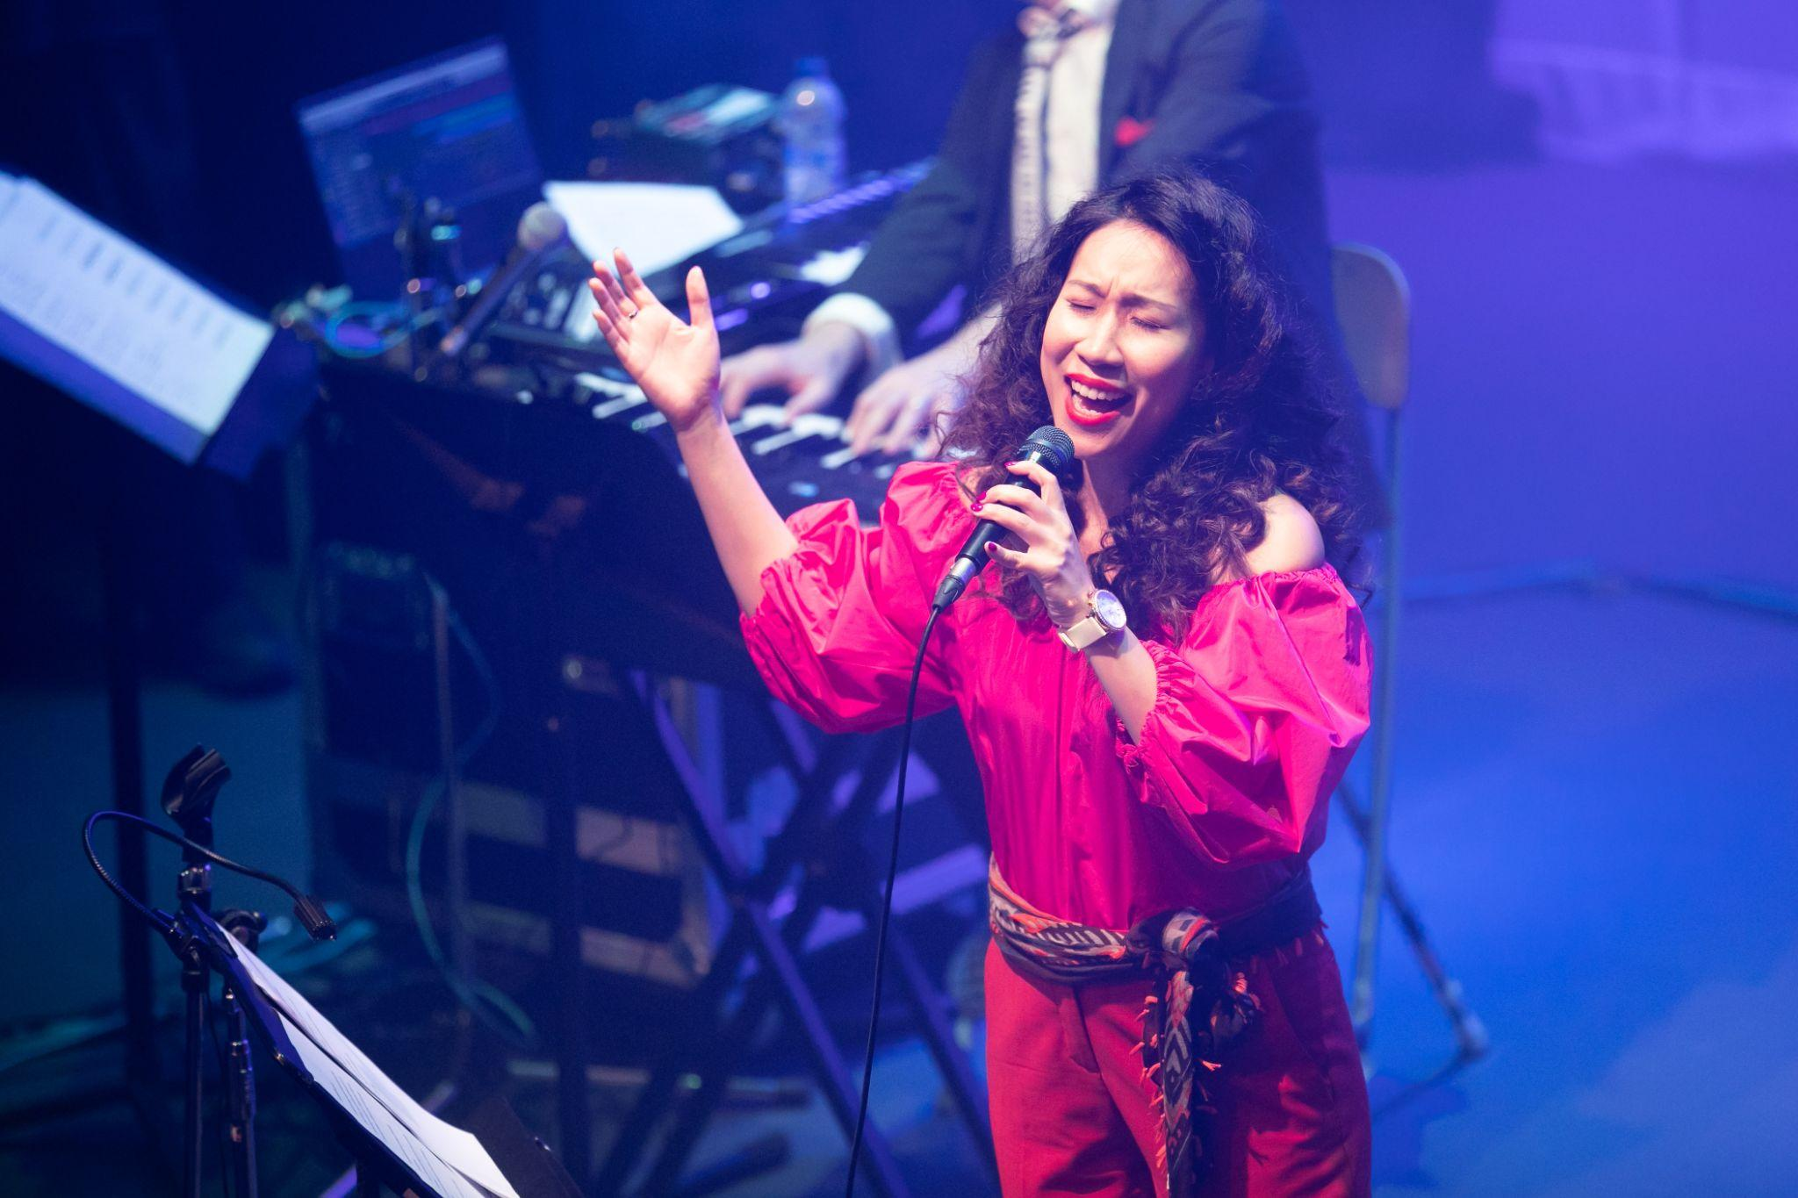
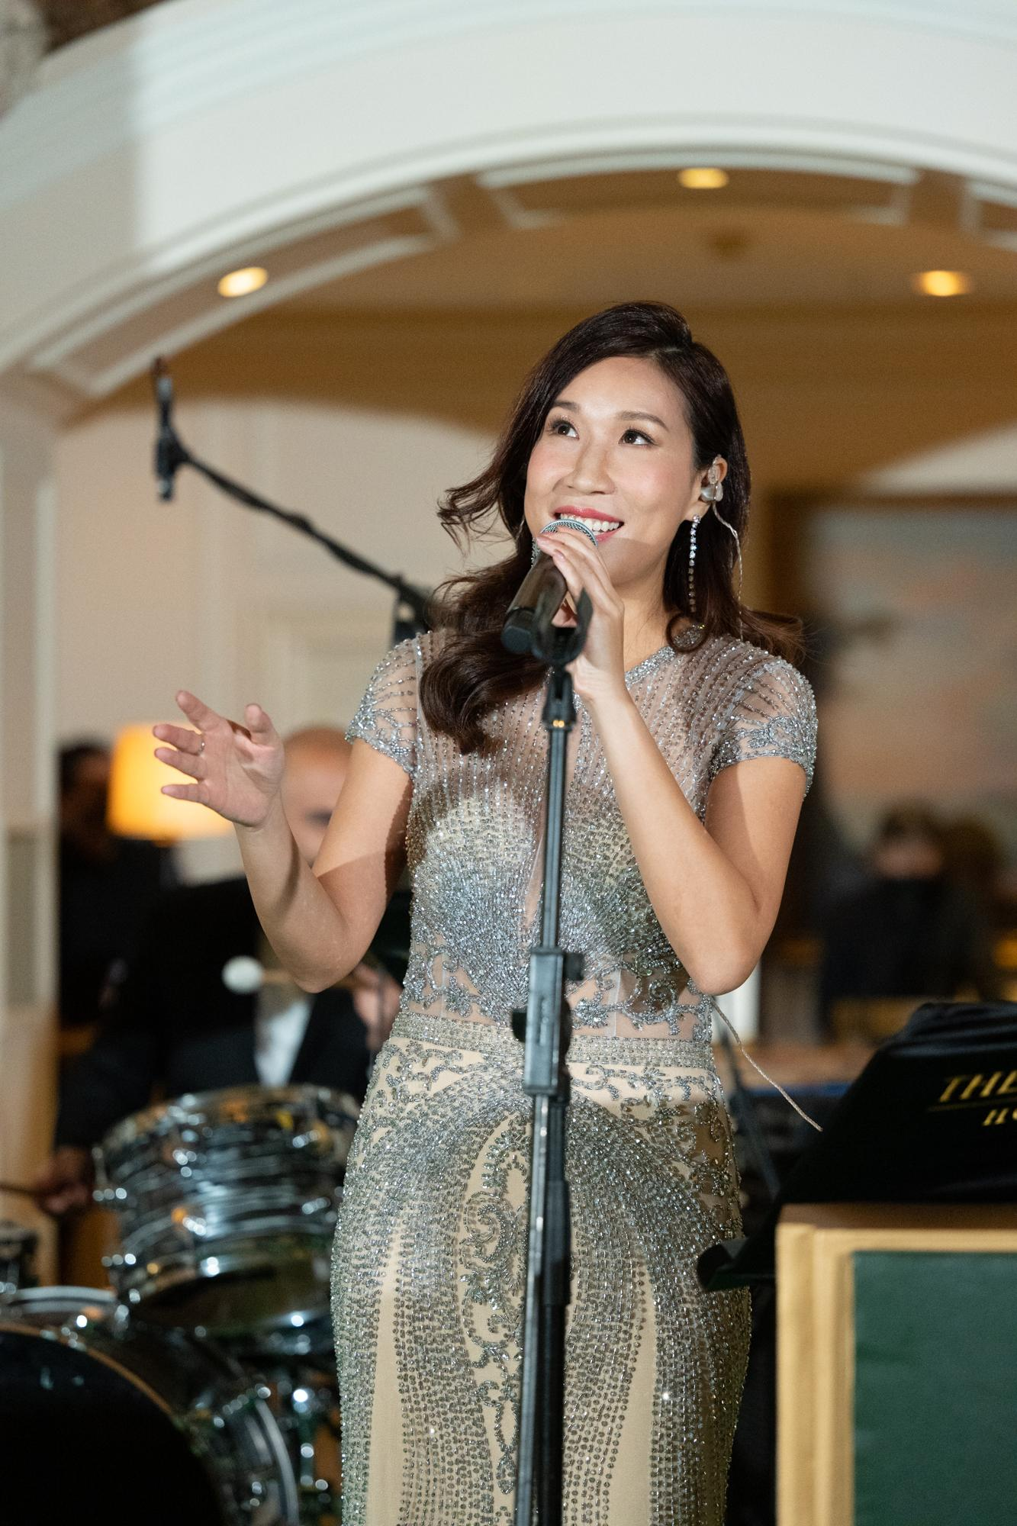
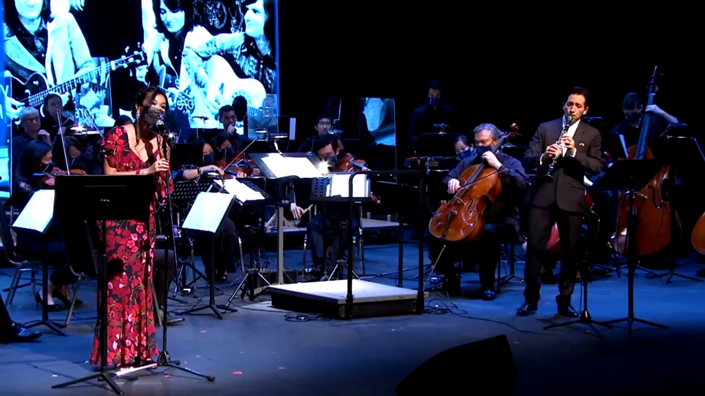

Slide 8
PAST CONCERTS
2022 “Ode to the Moon” Jazz Night for Mid-Autumn, Lobby, Peninsula HK
2022 “A Jazz Tribute to Italian Music”, Shaw Auditorium HKUST
2022 Make Music Hong Kong!, The Box, West Kowloon
2021 “A Jazz Tribute to Italian Music”, The Miller Theater, Asia Society Hong Kong Center
2021 Italian National Day Concert, Hong Kong City Hall Theatre
2021 “Synthing the 80s” Concert, Chai Wan Y Theatre and Shouson Theatre Arts Centre
2020 Freespace Jazz Festival, West Kowloon Freespace Terrace
2020 Hong Kong International Jazz Festival, Hong Kong City Hall Theatre
2019 Italian National Day Dinner, Four Seasons Hotel, Guangzhou & HB Town Changsha
2019 Tour in Beijing, Shanghai, Guangzhou and Hangzhou, Including: Hangzhou Jazz on the Lake Festival, Tsinghua University and Italian Chamber of Commerce Gala at Park Hyatt Beijing
2018 Tour in Beijing, Chongqing, Chengdu and Guangzhou
2018 Tour in Hong Kong, Guangzhou, Zhuhai and Macau, Including a TV performance at “The Work” RTHK and a sold out concert at Sai Wan Ho Civic Center organized by ICI
2018 Maratea Jazz Festival, Italy
2017 Salento International Film Festival, Tricase, Italy
2016 General States of Italian Language and Culture, Palazzo Vecchio, Florence, Italy

Slide 9
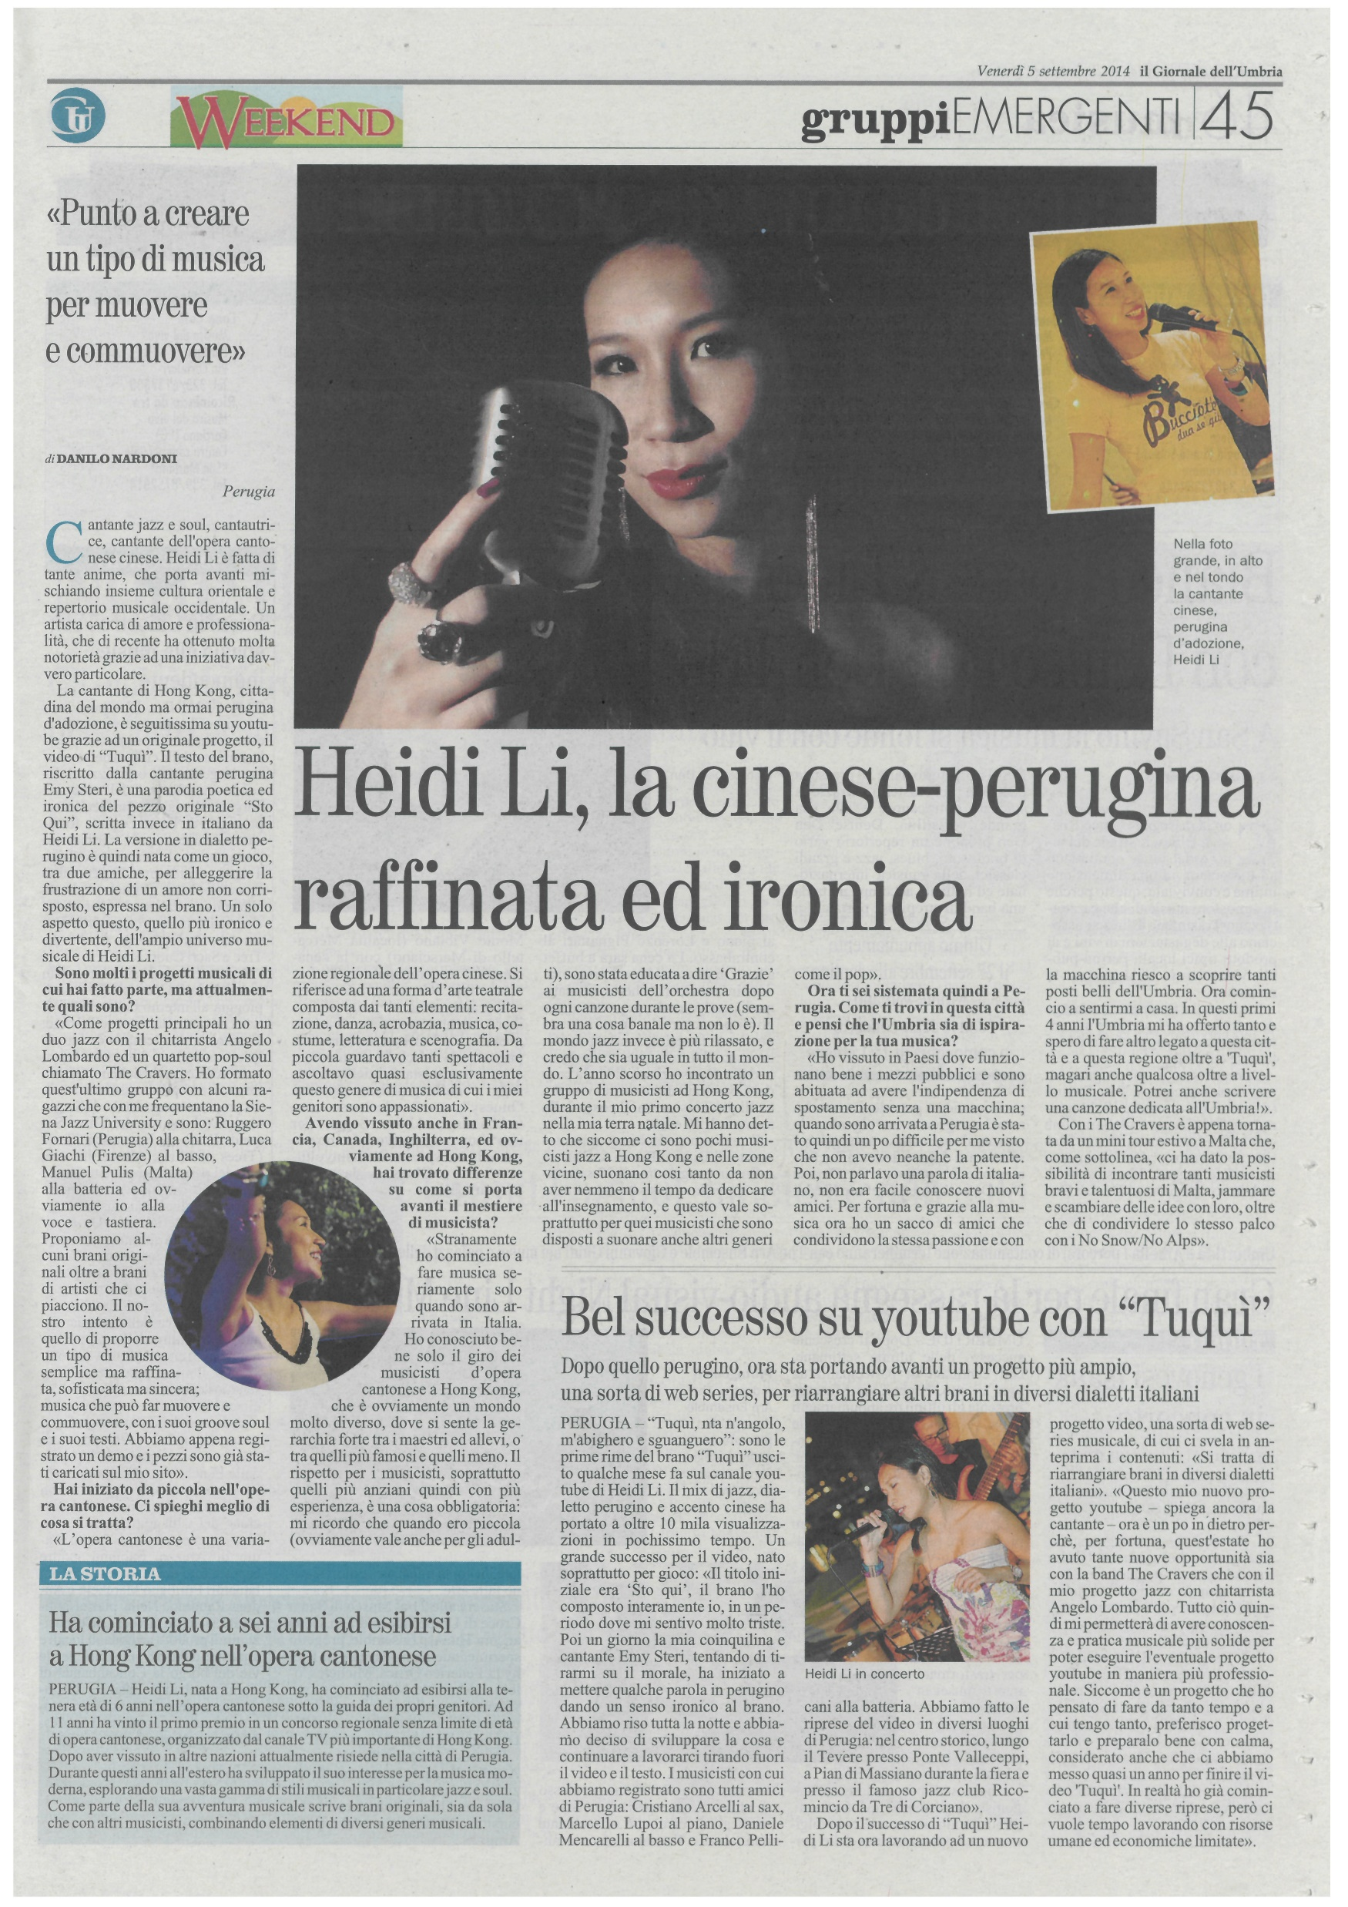

Slide 10
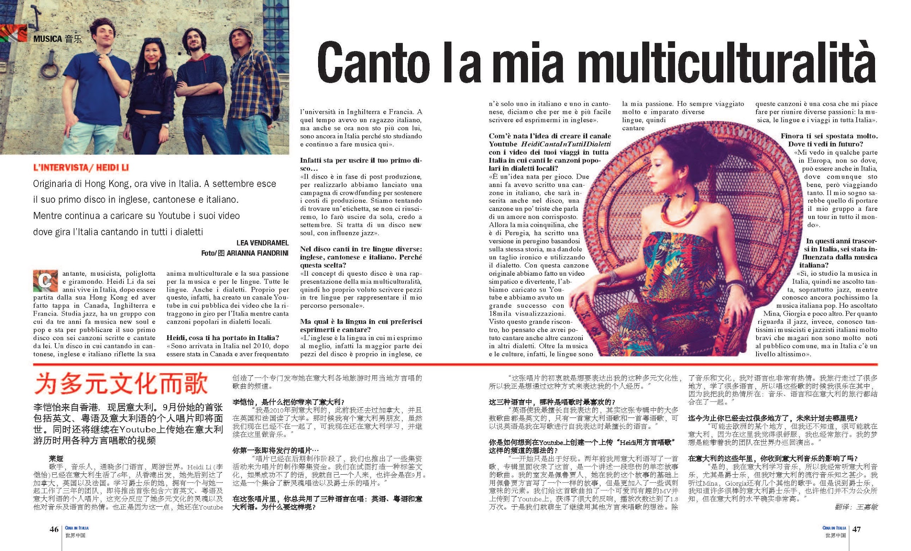

Slide 11
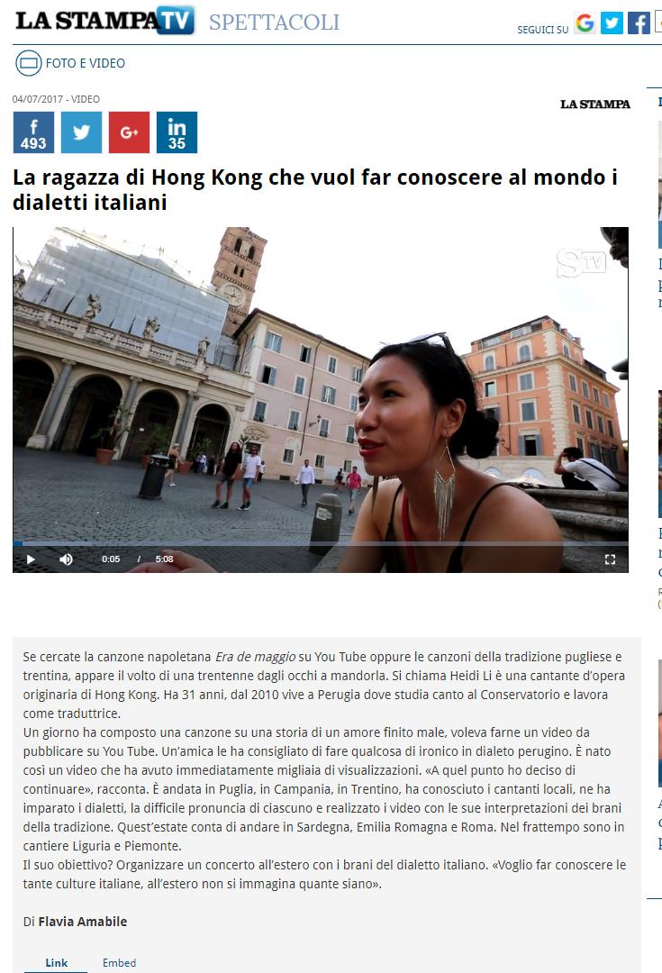

Slide 12
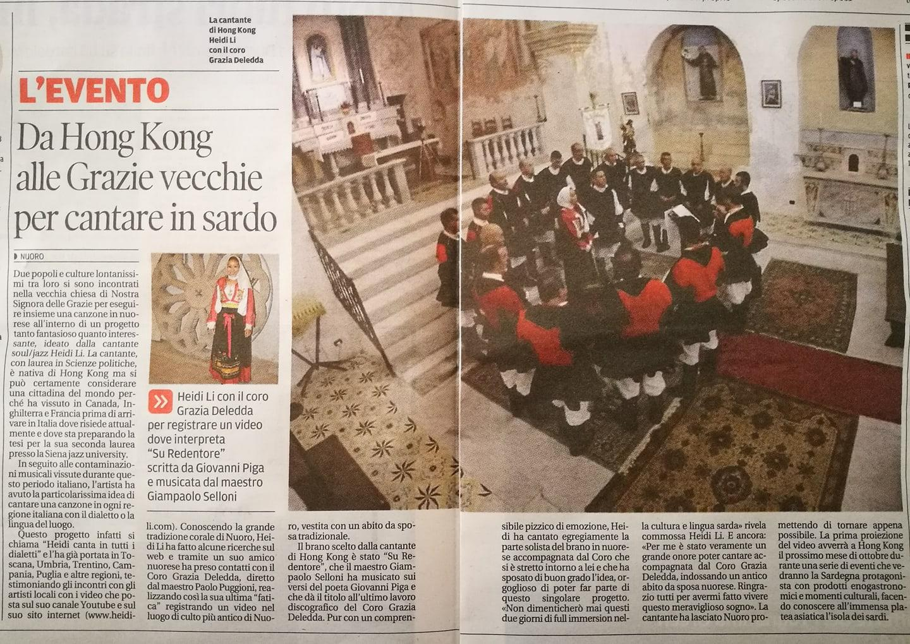

Slide 13
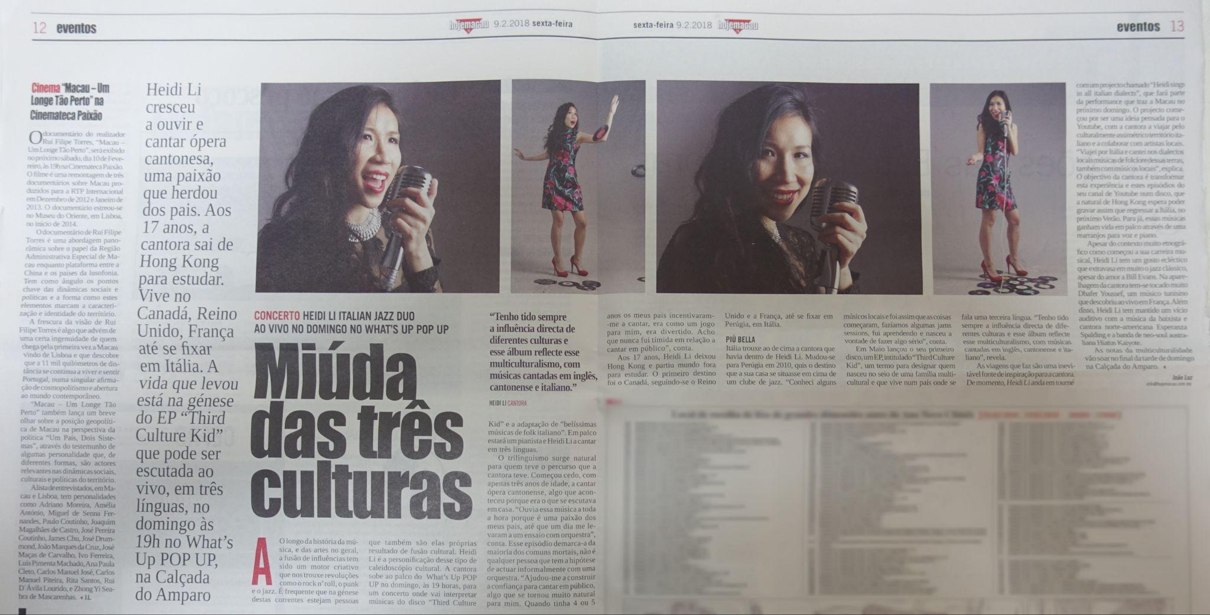

Slide 14
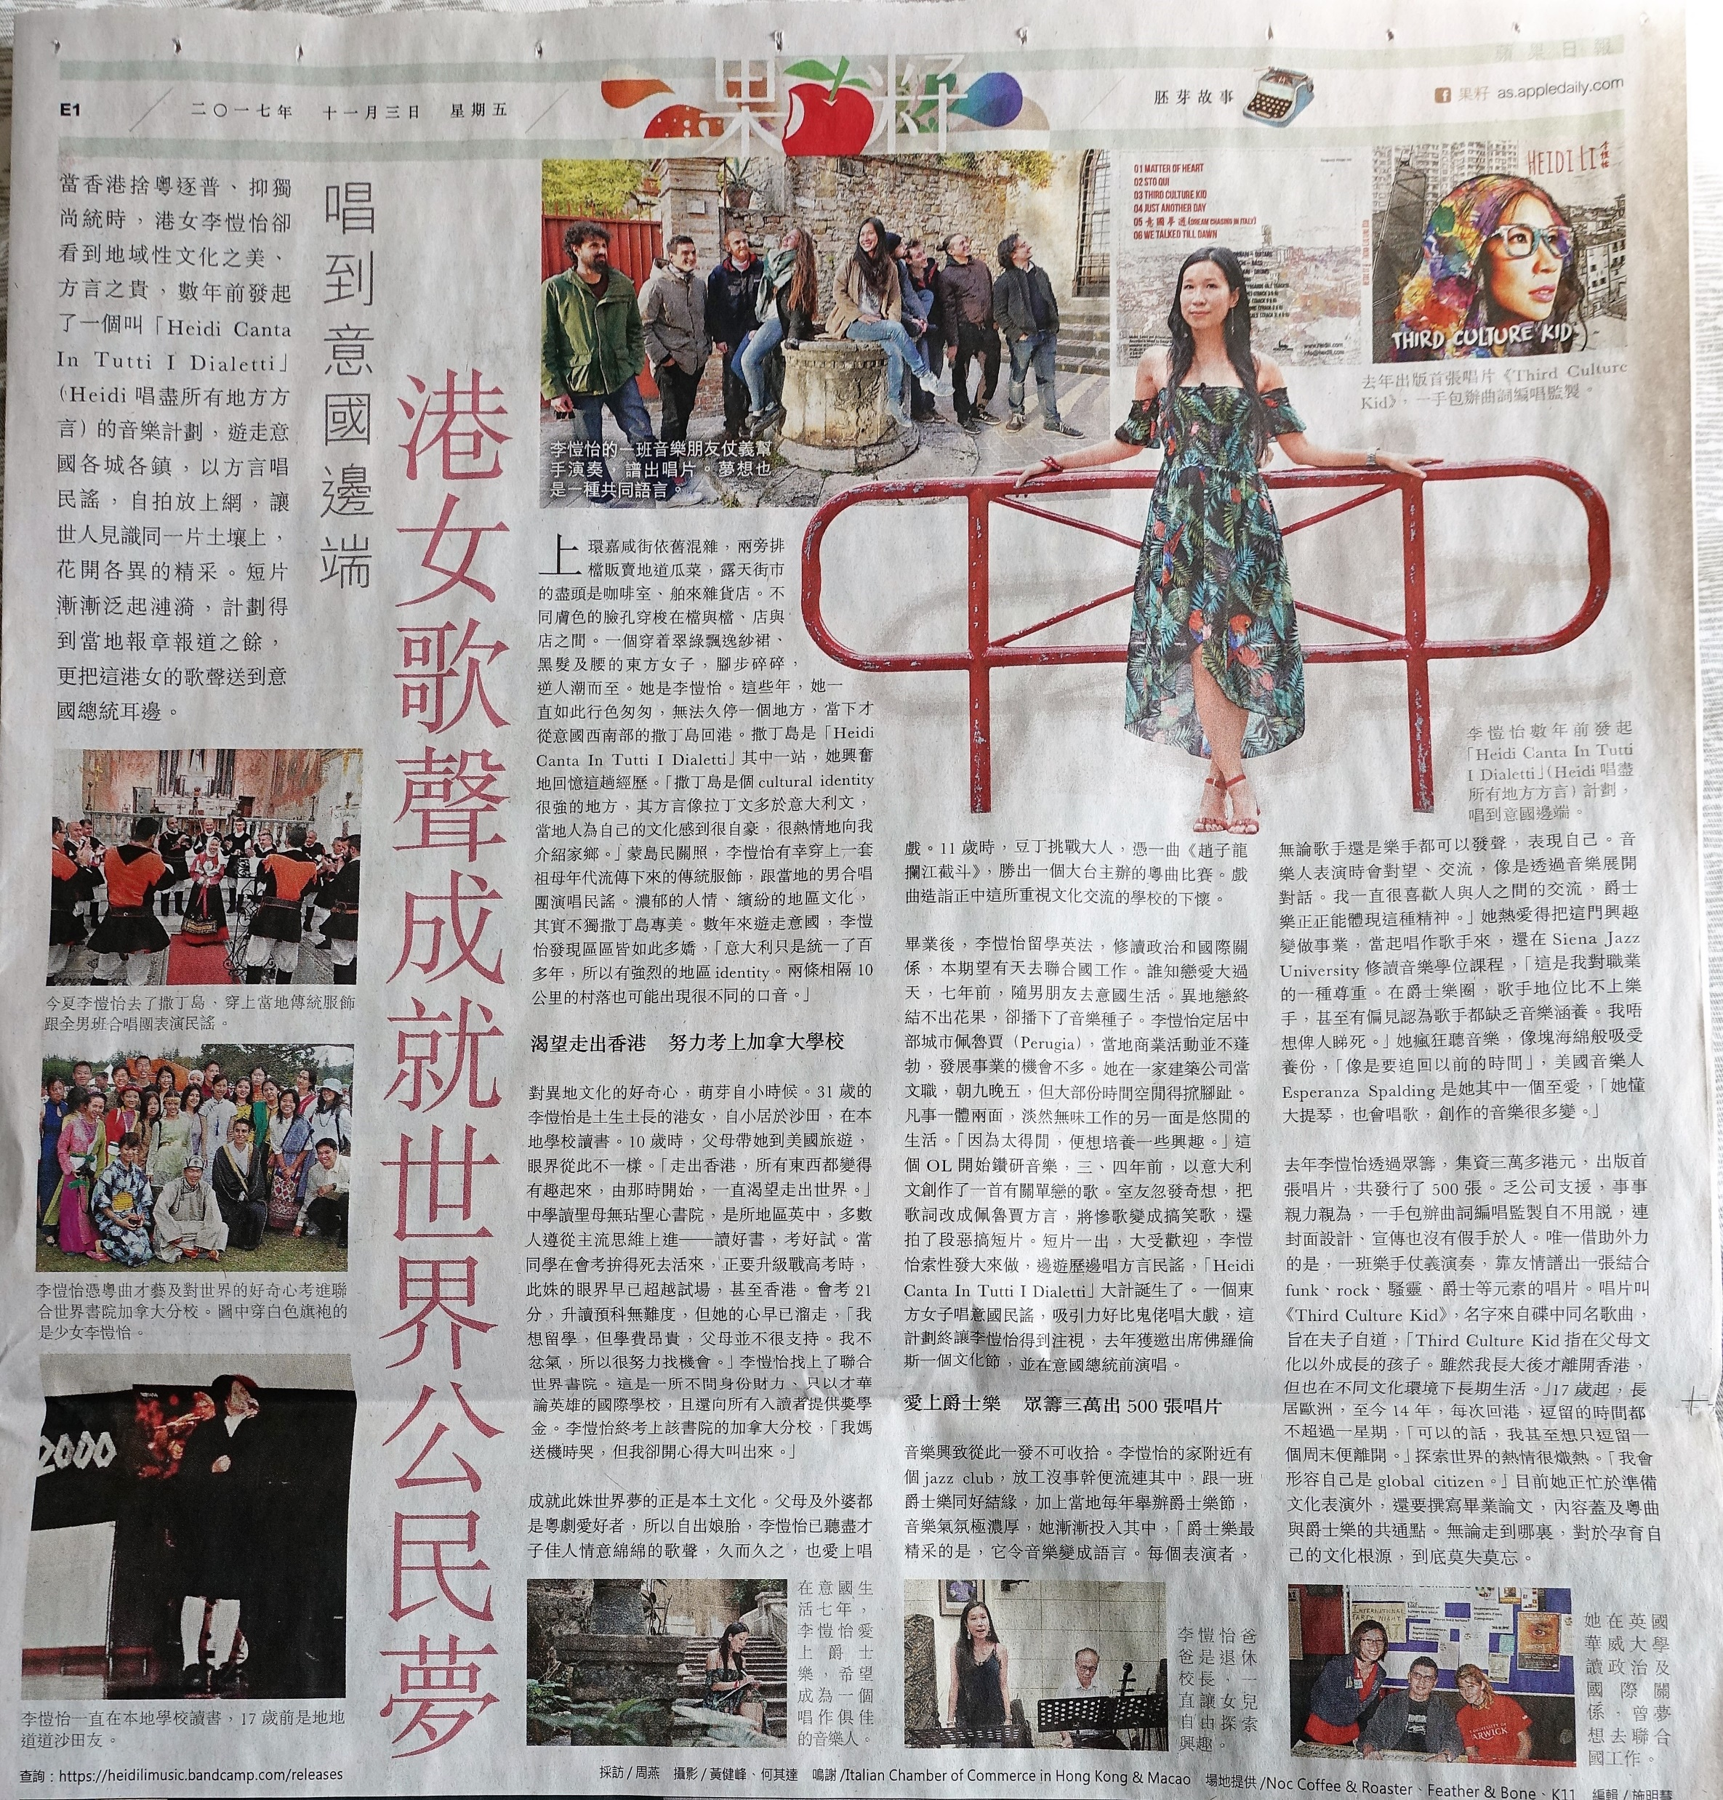

Slide 15
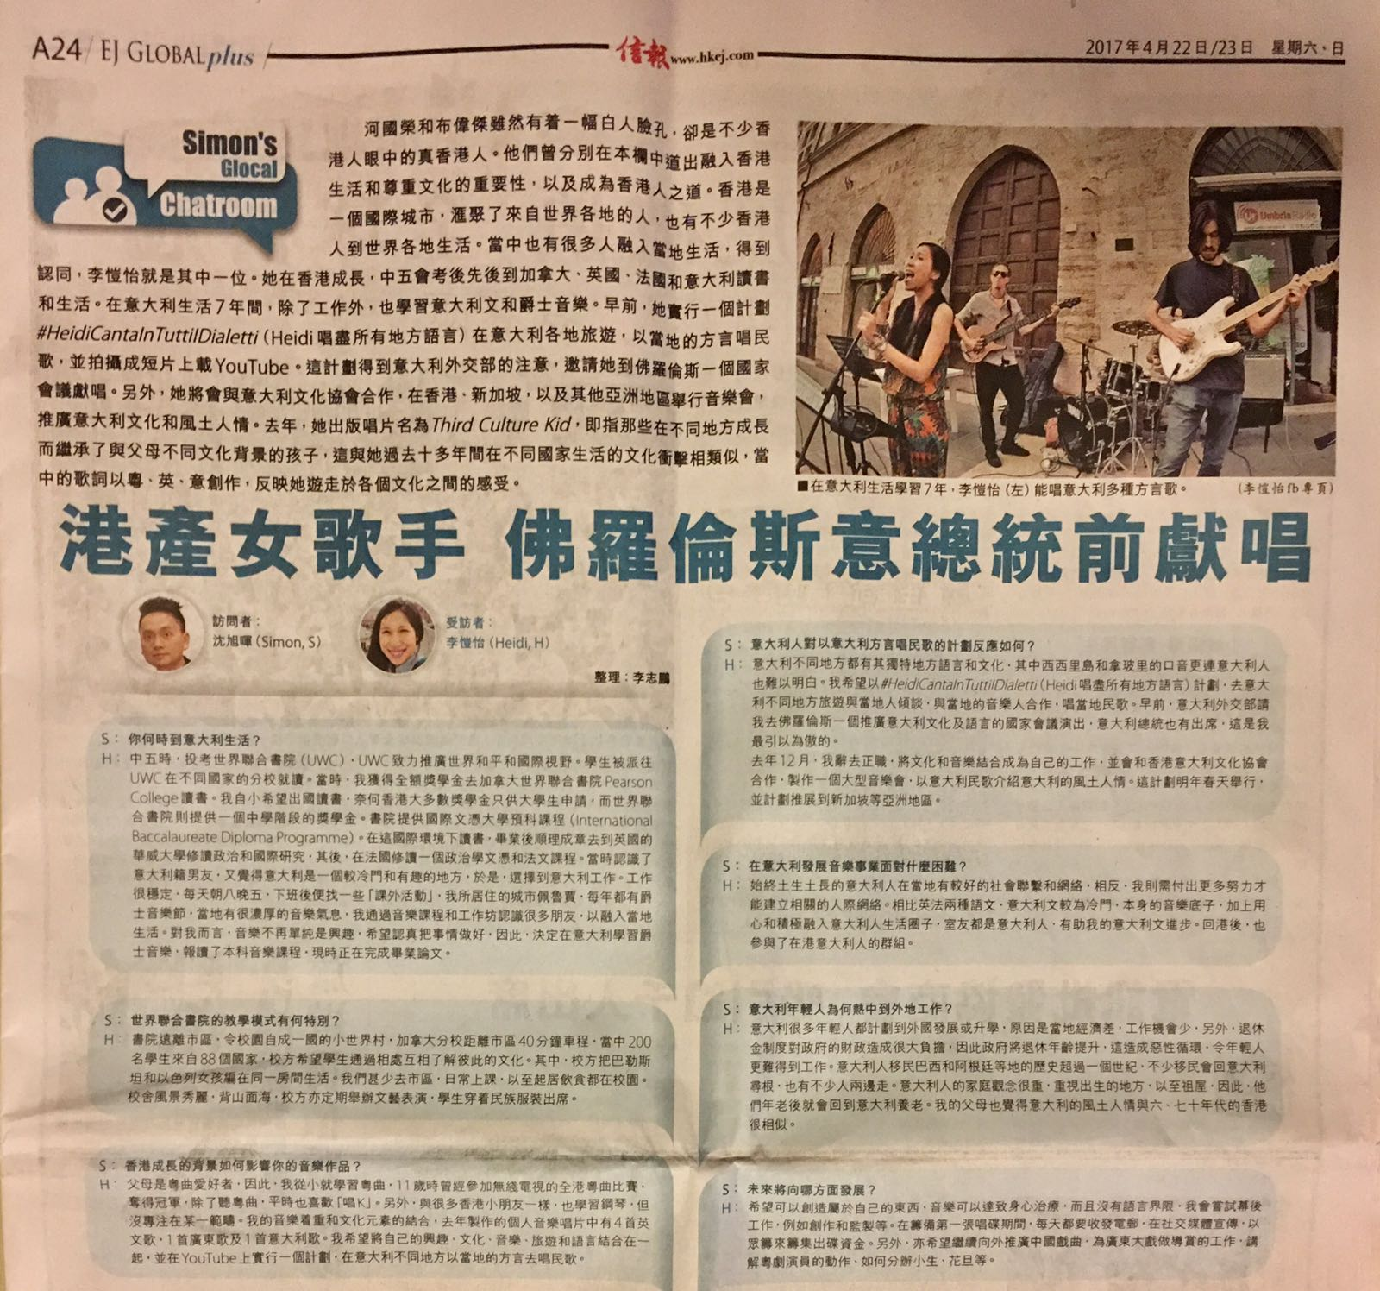

Slide 16

http://www.heidili.com
info@heidili.com
http://www.facebook.com/heidili.music
Tel: +39 3930113266
Skype: heidilihoiyi
Wechat: heidilihoiyi
https://www.youtube.com/channel/@HeidiLimusic

